Slide 1


Amazon Sales
Analysis
Presented by Mr Bhupesh

Slide 2
Content
Introduction
Objective
Details of Data
Main KPIs
My Design
Dashboard with Video formatting
Technology Use
Conclusion

Slide 3
Introduction
Amazon was founded on July 5,1994, by Jeff Bezos in Bellevue , Washington as an Online
marketplace.
Amazon has expanded its offerings to include various products and services.
In 2016,Amazon introduced a private label selling snack food items.
In 2019,it started offering milk delivery services.
Amazon is known for its customer –focused approach and has become a popular platform for both sellers and shoppers.
Amazon offered paid subscription service that provides users with various benefits such as same , one - or two day delivery of goods, streaming music ,video , e-books , gaming Prime Video and grocery shopping services.
Amazon Prime Video offers a subscription video on demand streaming service with a wide range of content available to users.

Slide 4
Objective
Sales Management has gained importance to meet increasing competition and the needs for improved method of distribution to reduce cost and to increase profits. Sales Management today is the most important function in a
Commerical and business enterprise.
Do ETL : Extract – Transform – Load Some Amazon Dataset
Sales –trend -> month_wise , year_wise , yearly_month-wise

Slide 5
Details of Data

Slide 6
Details of Data

Slide 7
Main KPIs
Revenue :It is a crucial financial money a company earns before deducting expenses.
Cost : Total Cost of all items to need a particular amount of money in order to buy or do something.
Profit : Profit is the financial gain a business makes after deducting all expenses from its revenue.
Profit Margin : Profit Margin is a crucial financial metric that indicates a company profitability by measuring the percentage of profit earned in a relation to its revenue.

Slide 8
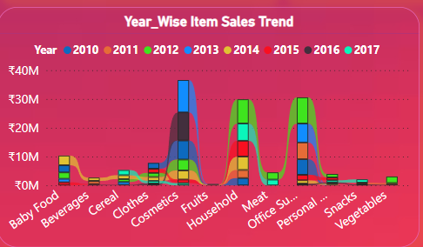
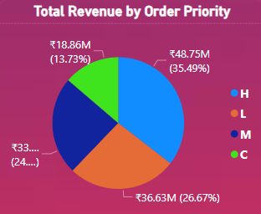
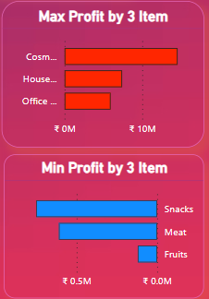
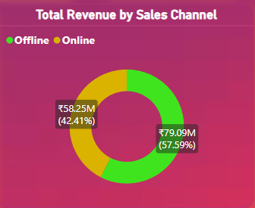
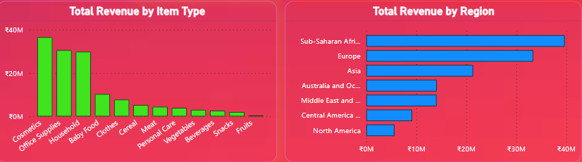
My Design
We can determine Year wise item sales by Ribbon chart
We Can Determine Max Profit gain by Top 3 Item by Clustered Bar Chart
We can determine total revenue by order Priority by Pie Chart
We can determine total Revenue by item type with Stacked Column Chart
We can determine total Revenue by Region with Clustered Bar Chart
We Can Determine Min Profit gain by bottom 3 Item by Clustered Bar Chart
We can Determine Total Revenue by sales channel by this Donut chart

Slide 9
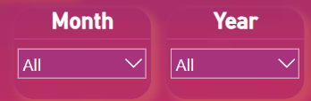
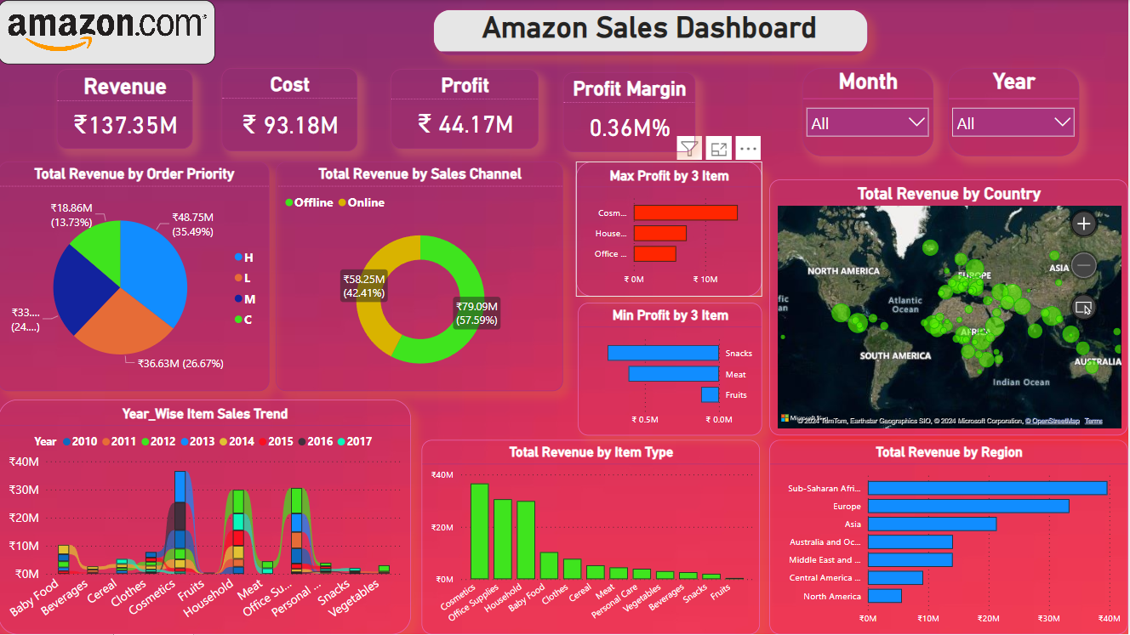
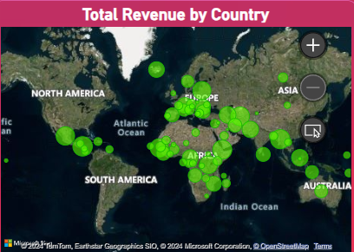
My Design
With the help of All Chart and Slicers we make a “Amazon Sales Dashboard” ,We can easily Analysis data of all items ,as per month-wise , yearly-wise sales trend.
With the help of Slicer we can easily determine Specific or all month and year data.
We can determine which country and specific area have more sales by the help of Map chart

Slide 10
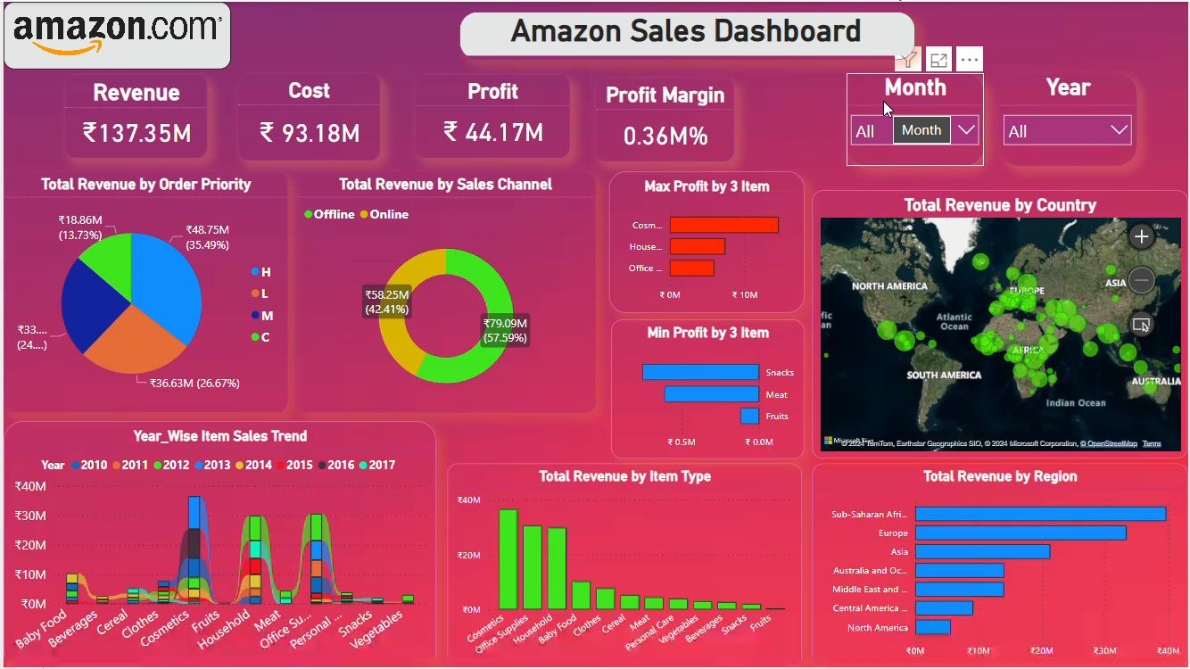
Dashboard with Video Formatting

Slide 11
Tool and Technology Use
In this project I will use Power BI Tools
Power BI is a powerful business intelligence tool developed by Microsoft
This tools easily to use ,Data Visualization , Data Connectivity And Cost Savings.

Slide 12
Conclusion
It is essential to analyze trends and insights provided by tools like Power BI. These tools offer valuable information on Sales history ,estimated monthly sales ,estimated yearly sales ,Item trends ,competition levels.
By Tracking sales trends and price fluctuations , sellers can identify profitable products for resale on Amazon
Additionally ,Amazon display of sales data and to provide customers with relevant information to make informed
Purchasing decisions.
Sellers can leverage this data to enhance visibility ,give special offer and discount on item to attracts more clients
And improve increase sales and profits performance by highlighting the quality and popularity of their items .
By interpreting these metrics over time and identifying trends ,sellers can optimize pricing strategies ,analyze ad
Performance , and make data – driven decisions to improve sales and customer satisfaction.
Utilizing external traffic sources like Facebook Ads ,Instagram Ads can also help sellers increase visibility on Amazon ,diversify their business and build a customer base outside the platform.

Slide 13
Thank
you!

